Slide 1
CMOS inverters

Slide 2
The inverter is truly the nucleus of all digital designs. Once its operation and properties are clearly understood, designing more intricate structures such as NAND gates, adders, multipliers, and microprocessors is greatly simplified. The electrical behavior of these complex circuits can be almost completely derived by extrapolating the results obtained for inverters.
The analysis of inverters can be extended to explain the behavior of more complex gates such as NAND, NOR, or XOR, which in turn form the building blocks for modules such as multipliers and processors. In this chapter, we focus on one single incarnation of the inverter gate, being the static CMOS inverter — or the CMOS inverter, in short. This is certainly the most popular at present and therefore deserves our special attention.

Slide 3
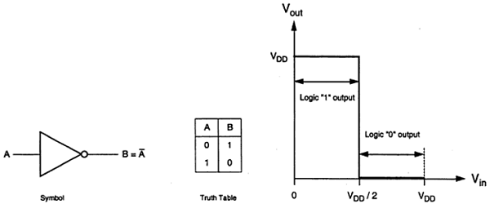
Principle of Operation
The logic symbol and truth table of ideal inverter is shown in figure given below. Here A is the input and B is the inverted output represented by their node voltages. Using positive logic, the Boolean value of logic 1 is represented by V_{dd} and logic 0 is represented by 0. V_{th} is the inverter threshold voltage, which is V_{dd} /2, where V_{dd} is the output voltage.
The output is switched from 0 to V_{dd} when input is less than V_{th}. So, for 0<V_{in}<V_{th} output is equal to logic 0 input and V_{th}<V_{in}< V_{dd} is equal to logic 1 input for inverter

Slide 4
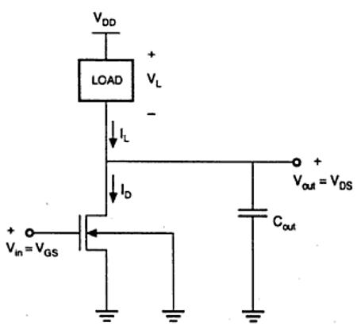
The characteristics shown in the figure are ideal. The generalized circuit structure of an nMOS inverter is shown in the figure below

Slide 5
From the given figure, we can see that the input voltage of inverter is equal to the gate to source voltage of nMOS transistor and output voltage of inverter is equal to drain to source voltage of nMOS transistor. The source to substrate voltage of nMOS is also called driver for transistor which is grounded; so V_{SS} = 0. The output node is connected with a lumped capacitance used for VTC

Slide 6
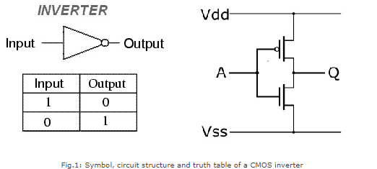
The inverter is universally accepted as the most basic logic gate doing a Boolean operation on a single input variable. Fig.1 depicts the symbol, truth table and a general structure of a CMOS inverter. As shown, the simple structure consists of a combination of an pMOS transistor at the top and a nMOS transistor at the bottom.

Slide 7
CMOS is also sometimes referred to as complementary-symmetry metal–oxide–semiconductor. The words "complementary-symmetry" refer to the fact that the typical digital design style with CMOS uses complementary and symmetrical pairs of p-type and n-type metal oxide semiconductor field effect transistors (MOSFETs) for logic functions. Two important characteristics of CMOS devices are high noise immunity and low static power consumption. Significant power is only drawn while the transistors in the CMOS device are switching between on and off states. Consequently, CMOS devices do not produce as much waste heat as other forms of logic, for example transistor-transistor logic (TTL) or NMOS logic, which uses all n-channel devices without p-channel devices.

Slide 8
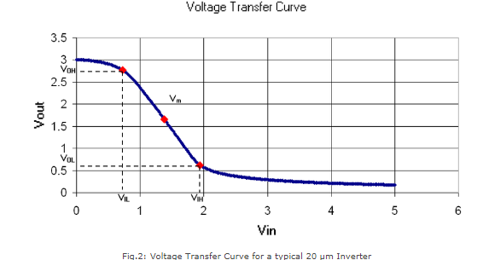
Inverter Static Characteristics (VTC)
Digital inverter quality is often measured using the Voltage Transfer Curve (VTC), which is a plot of input vs. output voltage. From such a graph, device parameters including noise tolerance, gain, and operating logic-levels can be obtained.

Slide 9
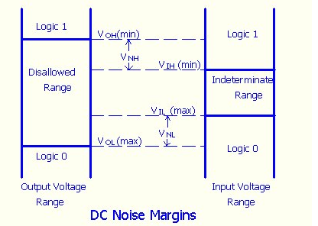
Ideally, the voltage transfer curve (VTC) appears as an inverted step-function - this would indicate precise switching between onand off - but in real devices, a gradual transition region exists. The VTC indicates that for low input voltage, the circuit outputs high voltage; for high input, the output tapers off towards 0 volts. The slope of this transition region is a measure of quality - steep (close to -Infinity) slopes yield precise switching. The tolerance to noise can be measured by comparing the minimum input to the maximum output for each region of operation (on / off). This is more explicitly shown in the fig.

Slide 10
Noise margin : is a parameter intimately related to the transfer characteristics. It allows one to estimate the allowable noise voltage on the input of a gate so that the output will not be affected. Noise margin (also called noise immunity) is specified in terms of two parameters - the low noise margin N_{L}, and the high noise margin N_{H} . Referring to above figure, N_{L} is defined as the difference in magnitude between the maximum LOW input voltage recognized by the driven gate and the maximum LOW output voltage of the driving gate. That is, N_{L} =|V_{IL} - V_{OL}|. Similarly, the value of N_{H} is the difference in magnitude between the minimum HIGH output voltage of the driving gate and the minimum HIGH input voltage recognizable by the driven gate. That is, NM_{H} =|V_{OH} - V_{IH}|. Where V_{IH}: minimum HIGH input voltage, V_{IL}: maximum LOW input voltage, V_{OH}: minimum HIGH output voltage, V_{OL}: maximum LOW output voltage

Slide 11
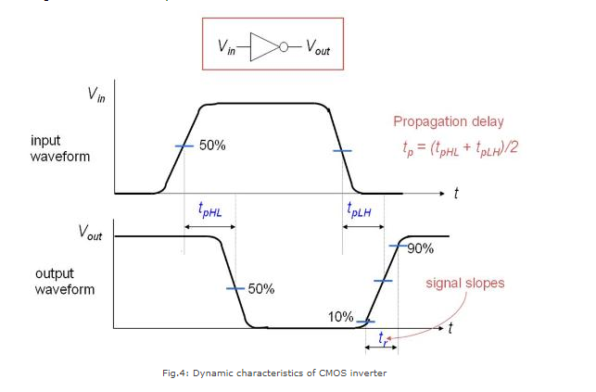
Inverter Dynamic Characteristics
Fig.4 shows the dynamic characteristics of a CMOS inverter. The following are some formal definitions of temporal parameters of digital circuits. All percentages are of the steady state values.

Slide 12
Rise Time (t_{r}) : Time taken to rise from 10% to 90%.
Fall Time (t_{f}): Time taken to fall from 90% to 10%.
Edge Rate (t_{rf}): (t_{r} + t_{f} )/2.
High-to-Low propagation delay (t_{pHL}): Time taken to fall from V_{OH} to 50%.
Low-to-High propagation delay (t_{pLH}): Time taken to rise from 50% to V_{OL}.
Propagation Delay (t_{p}): (t_{pHL} + t_{pLH})/2.
Contamination Delay (t_{cd}): Minimum time from the input crossing 50% to the output crossing 50%.

